Slide 1
Magenic Masters React Quiz
Feb 25, 2017
Mily Opena

Slide 2
Current Ranking
Ogot, Kim
Bocobo, Rhoderick
Paredes, Baron
Acido, Jayvee
Caraan, Eric
Briones, Marvin
Parungao, Leah
Pineda, Brian
Acosta, Jeff
Tolentino, Allan
Nieto, Shayne
Bagorio, Jennylyn
Catedral, Arnold
Labiano, Irish
Liwanag, Ronaldo
Jimenez, Paul
Alonzo, Jenny
Cervero, Jose
Abiad, Ervin
Cayetano, Jed
Lubi, Juvs

Slide 3
Implement Flux
Use the Flux pattern to manage the data in the Wishlist app.
Add the following functionalities:
Allow user to mark their wishlist item as a favorite.
Create a separate component that show the count of the user favorite wishlist items.
Separate the count data in a separate store.
Quiz will last for 60 minutes, first 35 minutes are free, each minute after the free minutes will be a deduction in your score.
Bugs, issues will be deducted in your score once the team submit their code for checking.
First team to complete the task will receive +10 in their quiz score.

Slide 4
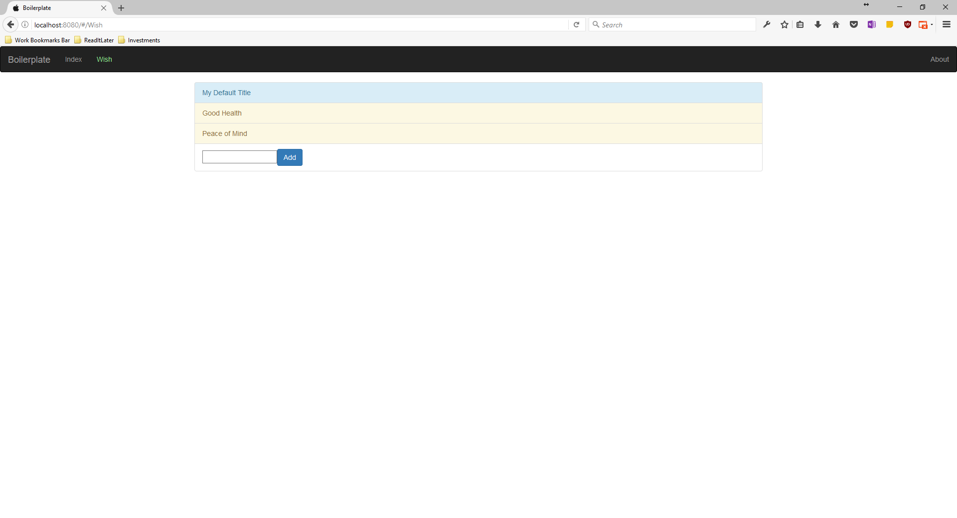
Wishlist App

Slide 5
Assignment #5
Use Flux to manage data of your tasks components.
Create a Priority Task List component that shows prioritized tasks (high priority/another flag)
Create a Task Form to be use to add tasks.
Bonus Points:
Show Priority Task List component as a popover on the header. (+5 on assignments)
Show Task Form component as a popover on the header. (+5 on assignments)
Make use of the ReduceStore, Container base classes of flux-utils (+1 on total grade)

Slide 6
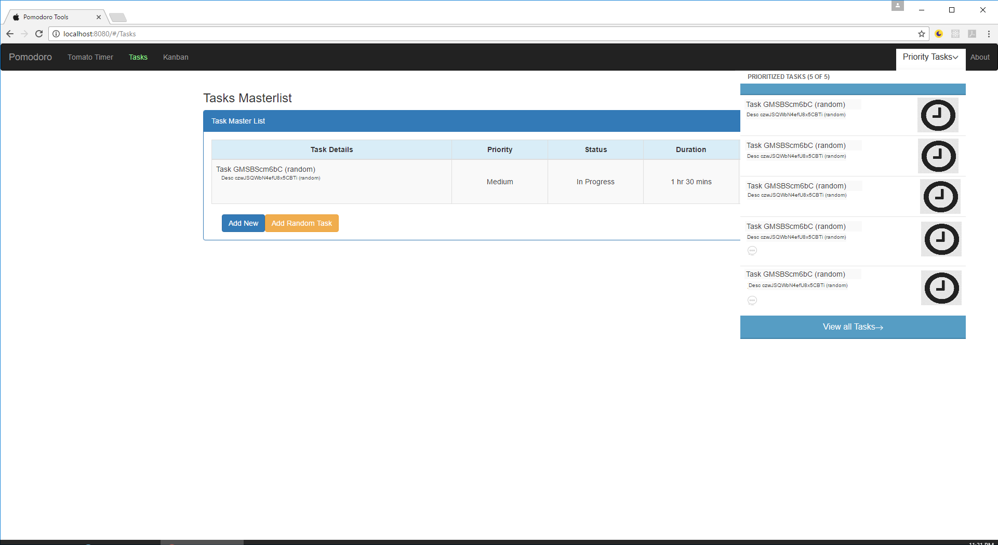
Assignment #5

